Slide 1
Information Processing Techniques
Week 01
Abeeha Sattar

Slide 2
Let’s Introduce Ourselves
Name: Abeeha Sattar
Qualifications: MS(CS) from IBA (2020), BS(CS) from FAST-NUCES (2016)
Experience: Worked in Systems Ltd. for about 1.5 years.
Tell me… your name, hobbies , your field of interest, and
your expectations from this course.

Slide 3
Office Location
Basement - II, Room # 16
Just check the time table before visiting!

Slide 4
Pre- Requisites
The course assumes that you have prior knowledge on the following:
Software Engineering
Programming Basics

Slide 5
Course Outline
- You may find the course outline on Google Classroom.
- Assignments:
Assignment # 1 – Week 3
Assignment # 2 – Week
- Quizzes
- Project:
Project Proposal – Week 2
Project SRS – Week 5
Project SDS, UI – Week 10
Project Presentations and Demos – Week 16

Slide 6
Grading Scheme
Assignments 5 %
Quizzes 5 %
Project 10 %
Midterms (2) 30 %
Final 50 %

Slide 7
Assignments Policies
No late submissions
Plagiarism on 1st assignment: 0 for that question
Plagiarism on 2nd assignment: 0 for that assignment

Slide 8
Reference Books
Clean Code: A Handbook of Agile Software Craftsmanship 1st Edition by Robert C.
Martin
Head First Design Patterns by Eric Freeman, Elisabeth Robson
Refactoring - Improving the Design of Existing Code by Martin Fowler, with Kent Beck
Software Architecture Patterns by Mark Richards, O’Reilly Media, Inc., 2015

Slide 9
Introduction to Java

Slide 10
History of Java
Java was originally developed by Sun Microsystems starting in 1991
– James Gosling
– Patrick Naughton
– Chris Warth
– Ed Frank
– Mike Sheridan
This language was initially called “Oak”
Renamed Java in 1995

Slide 11
What is Java?
A simple, object‐oriented, distributed, interpreted, robust, secure, architecture neutral, portable, high‐performance, multithreaded, and dynamic language

Slide 12
Object‐Oriented
– No free functions
– All code belong to some class
– Classes are in turn arranged in a hierarchy or package structure

Slide 13
Distributed
– Fully supports IPv4, with structures to support IPv6
– Includes support for Applets: small programs embedded in HTML documents

Slide 14
Interpreted
– The program are compiled into Java Virtual Machine (JVM) code called bytecode
– Each bytecode instruction is translated into machine code at the time of execution

Slide 15
Robust
– Java is simple
– no pointers/stack concerns
– Exception handling
– try/catch/finally series allows for simplified error recovery
– Strongly typed language – many errors caught during compilation

Slide 16
Java Development Environment
Edit – Create/edit the source code
Compile – Compile the source code
Load – Load the compiled code
Verify – Check against security restrictions
Execute – Execute the compiled

Slide 17
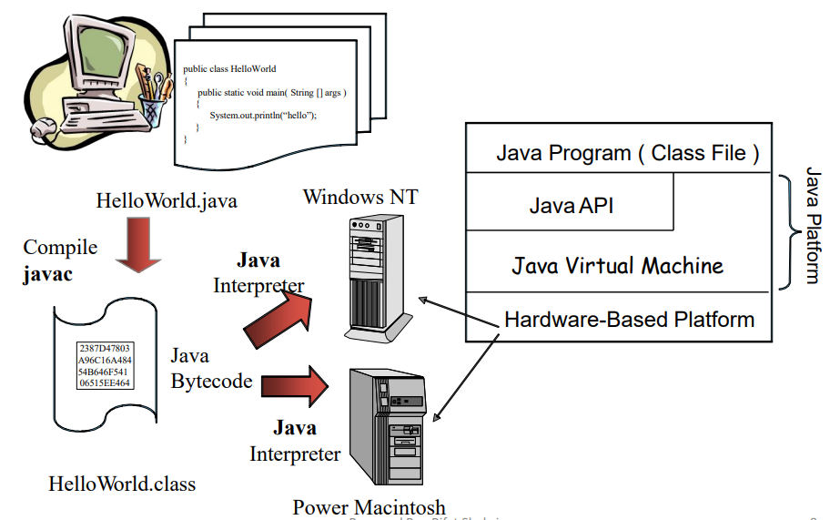
Java Platform

Slide 18
Bytecode
They are not machine language binary code
They are independent of any particular microprocessor or hardware platform
They are platform‐independent instructions
Another entity (interpreter) is required to convert the bytecodes into machine codes that the underlying microprocessor understands
This is the job of the JVM (Java Virtual Machine)

Slide 19
JVM (Java Virtual Machine)
It is a part of the JDK and the foundation of the Java platform
It can be installed separately or with JDK
A virtual machine (VM) is a software application that simulates a computer, but hides the underlying operating system and hardware from the programs that interact with the VM
It is the JVM that makes Java a portable language

Slide 20
JVM (Java Virtual Machine)
The same bytecodes can be executed on any platform containing a compatible JVM
The JVM is invoked by the java command – java Welcome
It searches the class Welcome in the current directory and executes the main method of class Welcome
It issues an error if it cannot find the class Welcome or if class Welcome does not contain a method called main with proper signature

Slide 21
JIT Compiler
When a JIT compiler is part of the JVM, selected portions of bytecode are compiled into executable code in real time, on a piece-by-piece, demand basis.
An entire Java program is not compiled into executable code all at once, in this case.
Not all sequences of bytecode are compiled—only those that will benefit from compilation.
The remaining code is simply interpreted.

Slide 22
Commands for Reference:
Use javac <filename>.java to compile a java file using the command prompt
Use java <classname> to execute the class file that was generated by the javac command.

Slide 23
Fin.

